Slide 1
Augmented reality TECHNOLOGY
ESRC Lab – VR Team
Presenter: Nguyen Minh Hieu
Oct-5 2018

Slide 2
CONTENTS
Types Of AR
AR Related Technologies
AR Components And Devices
Notes:
Nội dung gồm 4 phần
Overview; Giới thiệu tổng quan về AR
Applications: Các ứng dụng của AR trong các lĩnh vực của đời sống cũng như học tập, nghiên cứu
Technology used in AR: Tóm tắt các công nghệ được sử dụng trong AR
So sánh VR và AR

Slide 3
Types of AR
There are 4 major types of AR:
Marker-based AR (also called Image Recognition or Recognition-based AR)
Marker-less AR (also called Location-based or Position-based AR)
Projection-based AR
Superimposition-based AR
Each type of AR has a different use in the different case

Slide 4
Marker-based AR
Requires a visual object and a camera (in AR device) to scan it
A object may be anything, e.g: a printed QR code or a 2D image
Process
The users get the result when camera reader senses the marker
Scan the object
Calculate the position and orientation of the object
Overlay the information or the 3D object on the scanned object by the marker

Slide 5
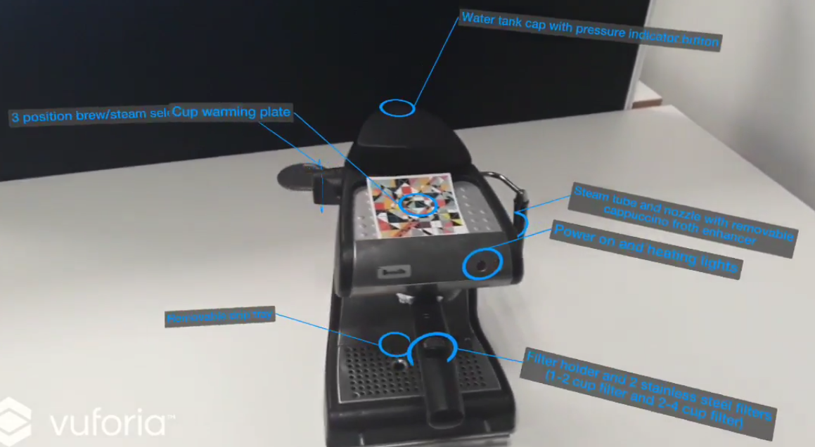
Uses of the marker-based AR
It detects the object and gives information about it

Slide 6

Uses of the marker-based AR
It translates the words using Optical Character Recognition technology

Slide 7
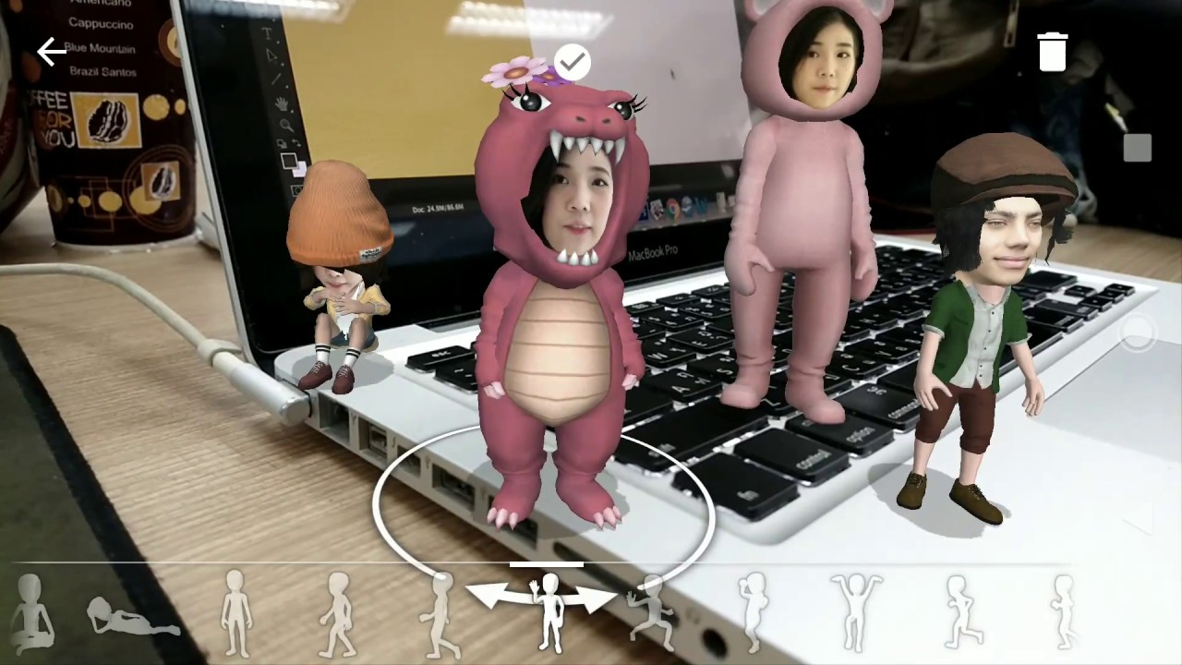
Uses of the marker-based AR
It creates 3D objects to simulate the architecture or to entertain

Slide 8
Marker-less AR
Is the only type of AR which does not use any kind of recognition system
Uses various location tools: GPS, digital compass, velocity meter, gyroscope accelerometer
Process
This type of AR is one of the most used technology, typically produces maps and directions, searchs the nearby places and predicts the locations where the user wants to go
Applications using this type of AR include events and information, business ads pop-ups, navigation support,…
Detect user’s location an orientation on the map
Read the data through GPS, determine what AR content to find or get in a certain area
Show the relevant information on the screen

Slide 9
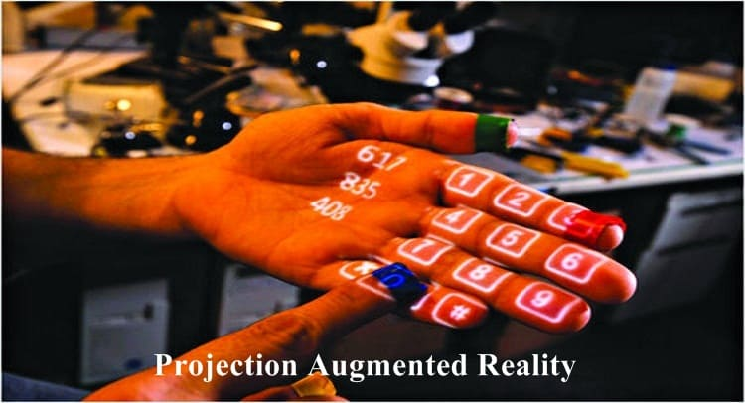
Projection-based AR
Evident to its name, this type of AR is based on lights from the device projected on the objects
In some cases. this type of AR allows user to interact with the holograms
Example: When the light of the calculator is thrown through projection-based AR device on your palm, the 12 partitions in your hand will become 12 buttons and a user can touch these buttons and can interact with them

Slide 10
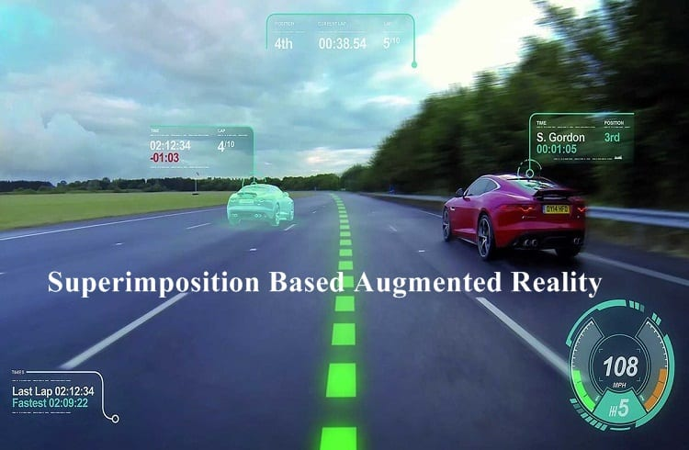
Superimposition-based AR
In this technology, the augmented image can replace the original image, either partially or fully
The technology is useful in the medical field, helps the doctor to examine patient thoroughly; or in a military, it can offer multiple views of a target

Slide 11
AR Related Technologies
AR involves some following technologies:
SLAM - Simultaneous Localization And Mapping
Depth tracking: Briefly, a sensor data calculating the distance to the objects
Recognition technology (Marker-based AR)
Location technology (Marker-less AR)

Slide 12
SLAM - Simultaneous ALocalizationnd Mapping
Used in self-driving cars, unmanned aerial vehicles, autonomous underwater vehicles, planetary rovers, newer domestic robots and even inside the human body
E.g: Estimate the pose of a robot and the map of the environment at the same time
Localization: Inferring location given a map
Mapping: Inferring a map given locations
SLAM: Learning a map and locating the robot simultaneously
So, there are two basic problems in SLAM:
A map is needed for localization
A pose estimate is needed for mapping
→ SLAM is a chicken-or-egg problem

Slide 13
How is SLAM involved AR
SLAM helps AR developers to create much more interactive and realistic experiences
E.g: One of the AR phrase is recognizing walls and barriers and also floors
Right now most AR SLAM technologies like ARKit only use floor recognition and position tracking to place AR objects around the user
→ Don’t actually know what’s going on in your environment to correctly react to it
More advanced SLAM technologies like Google Tango, can create a mesh of our environment
→ Not only the machine can tell you where the floor is, but it can also identify walls and objects in your environment allowing everything around you to be an element to interact with

Slide 14
AR Components And Devices
Basic components in a AR system:
Cameras and sensors: May be special duty cameras, like in Microsoft Hololens, or common smartphone cameras to take pictures/videos
Processing: AR technology requires a CPU, a GPU, flash memory, RAM, Bluetooth/WiFi, a GPS, etc. to be able to measure speed, angle, direction, orientation in space, and so on, like in modern smartphones
Projection: Takes data from sensors and projects digital content (result of processing) onto a surface to view
Reflection: Assist human eyes to view virtual images by mirrors
Collect data about user’s interactions
Send the collected data for processing
With this data, the device locates physical objects and generates 3D models

Slide 15
AR Devices:
Mobile devices (smartphones and tablets): The most available and best fit for AR mobile apps
Special AR devices: are designed primarily and solely for AR experiences. A example is head-up displays (HUD), sending data to a transparent display directly into user’s view.
AR glasses (or smart glasses): Google Glasses, Meta 2 Glasses, Laster See-Thru, Laforge AR eyewear, etc. These units are capable of displaying notifications from your smartphone, assisting assembly line workers, access content hands-free, etc.
AR contact lenses (or smart lenses): take AR one step even farther. Manufacturers like Samsung and Sony have announced the development of AR lenses
Virtual retinal displays (VRD): create images by projecting laser light into the human eye. These system have bright, high contrast and high-resolution images

